Slide 1
The Impacts of Broadband
Research Findings from the Broadband Economists
Michael Curri Doug Adams
President Head of Communications
Blandin Foundation Conference Webinar
November 8, 2012 - Minnesota

Slide 2














We are the “Broadband economists”
WE ARE a global leader in broadband planning for socio-economic development
WE PROVIDE data and insights to increase
broadband utilization and impacts
WE DELIVER strategies for economic development
and community transformation through broadband
Some of our clients:
UK Department of Trade
and Industry

Slide 3
Why we Build Broadband Networks
Operators
Revenues from client subscriptions
Investment and maintenance costs
= PROFIT
Local Economy
Increased productivity and competitiveness,
increased revenues, new jobs,
better quality of life, etc.
Investment, maintenance, support
= BENEFITS FOR THE COMMUNITY
“Off- balance-sheet”
© Strategic Networks Group, Inc. 2012
Notes:
Investing in broadband is all about increasing productivity and improving quality of life.
Investing in broadband requires demonstrating a positive community ROI.
Productivity, transformation, innovation.
SNG’s data details how broadband increases productivity, whether for governments, businesses, or households.

Slide 4
Broadband Direct Impacts
Benefits from the Digital Economy

Slide 5
Broadband’s Profound Impact
on Job Creation
Broadband is responsible for 22.4% of all new jobs
  Percent of New Jobs
  Related to Internet
  By Size of Employer Group
Small businesses create 12x more Internet jobs relative to large firms
© Strategic Networks Group, Inc. 2012
Source: SNG Digital Economy Database n = 3,574 from NC, VA and KY collected in 2010-12

Slide 6

Broadband and Communities
Broadband retains and attracts population and businesses
    38% of households said they would definitely, or likely, relocate if broadband was not available
    32% of households have a home-based business, with 14% planning to start one in the coming year
    72% of home-based businesses say broadband was essential for their business
    55% of business and organizations said broadband is essential for remaining in current location
Source: SNG Digital Economy Database n = 34,000
Notes:
6

Slide 7
ROI from Broadband Networks
SNG projects have revealed common return on investment (ROI) multipliers
from broadband investments
Economic ROI from Public Investments in Broadband
Contribution to GDP | 10 x the initial public investment
Number of Jobs created and saved | Variable
Fiscal revenues increase | 3 to 4 x the initial public investment
Average multipliers identified from economic impact studies conducted by SNG.

Slide 8
Build It and They Will Come????
The Marketing Theory Behind Why
Building Is NOT Enough

Slide 9

Utility vs.Technology
Utility | Technology
Basic Need (water, roads, electricity) | A Luxury, a “nice to have” (smart phone, DVR, HD TV)
Basic Internet Service | Ultra fast and/or fiber Internet Service
The “Broadband is a Utility” argument discounts the fact that adopting better broadband is a technology upgrade decision.
In 2012, to maximize broadband’s benefits and drive innovation, business, organizations and households must adopt and utilize…
  E-Solutions
  Ultra-fast broadband

Slide 10
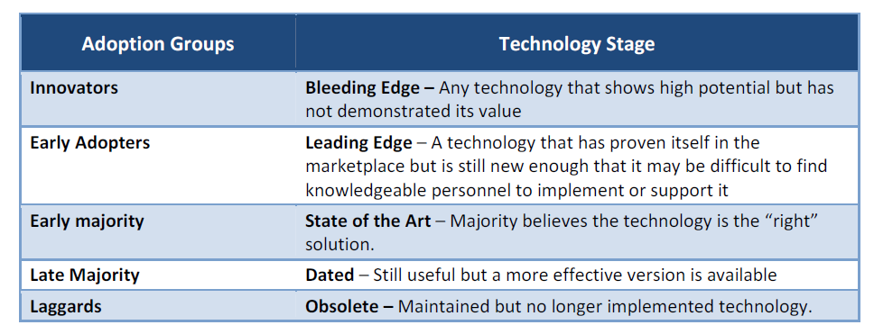
Technology’s Adoption Groups
We all tend to fall somewhere on the “technology adoption curve”
“Innovators” alone will not create a sustainable network
This is the “nature part of the equation of broadband’s consumers (stay tuned for the nurture)

Slide 11
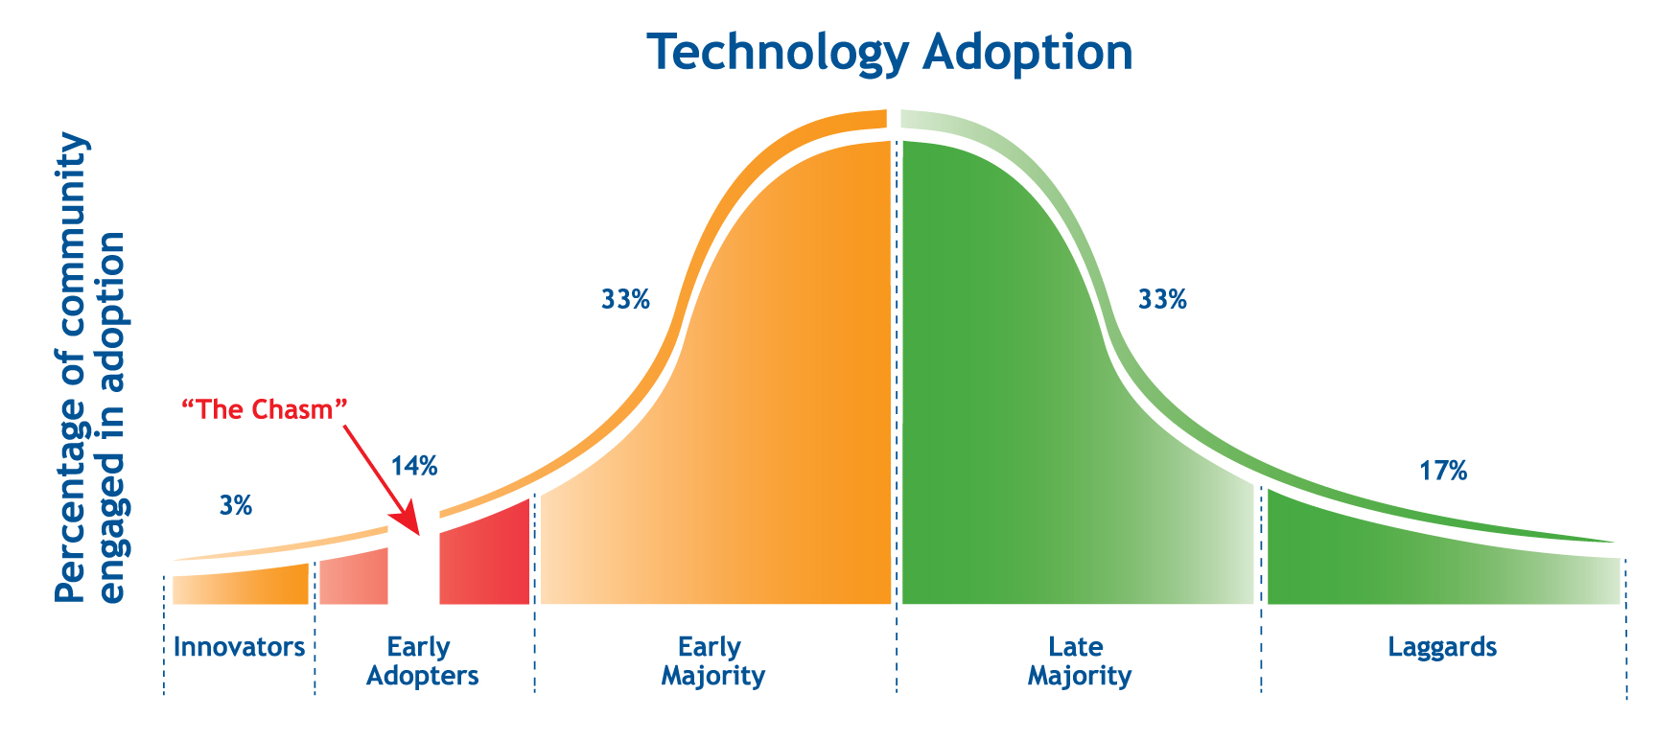
“Crossing the Chasm” *
Innovators buy features, The rest of us want benefits
“Faster” is not a benefit!
* Geoffrey A. Moore, 1991

Slide 12

2 Simple Steps (But Not 1)
Education – driving understanding of the benefits
of ultra-fast broadband
Close – getting the household, company, organization
to actually signup
So how do we do this????

Slide 13
And to the Nurture…
The theory of “Diffusion of Innovations” tells us that you can NURTURE a person’s nature by doing the following…
Explain the technology – Distinguishing the difference and the promise of the new technology
Create a communications plan to reach target audience(s)
Reduce the time it takes to realize benefits by ratcheting up Knowledge of ROI, benefits, etc.
Use the social system (Influencers) to tout the technology’s advantages

Slide 14
Driving Utilization
Technology is not enough

Slide 15
One Factor is not Enough
In the Broadband Equation,
the quality of each input affects the output
Lagging Technology
Skills
Average
Technology
No Skills
Average
Technology
Skills
BENEFITS

Slide 16
Experience Matters as much as Technology
Optimized broadband utilization is not inborn, but acquired
Source: SNG Digital Economy Database n = 14,176 from NC, VA, KY and LA collected in 2010 and 2012

Slide 17
The Biggest Barrier is Not Knowing
Fear of the unknown overrules slow Internet as a barrier
Source: SNG Digital Economy Database n = 12,177 from NC, VA, KY and LA collected in 2010 and 2012

Slide 18
Adoption and Utilization Is Key
How SNG Helps Drive Utilization

Slide 19
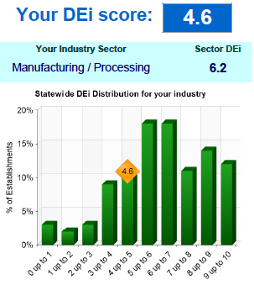
How SNG Measures Utilization
We uncover Internet use at a micro-level
and benchmark against peers
17 e-solutions¹ by organizations
30 e-solutions¹ by households
Utilization data collected² by SNG directly
From 23,000 businesses / organizations
And 11,000 households (a normative database).
Results shown use SNG’s Digital Economy index (DEi), a composite score
between 1 and 10 to reflect level of Internet utilization.
DEi scoring process enables
comparisons and rankings by sector or region
1. Internet-enabled applications and processes; 2. Between 2008-2012

Slide 20
Increased Utilization Directly
Correlates to Revenue Growth
Businesses underutilizing the Internet miss significant revenue opportunities
Source: SNG Digital Economy Database n = 1,202 from NC, VA and KY collected in 2010-12

Slide 21
The adoption process
for e-solutions by businesses
Fast / Early Adoption
Utilization
Highest value,
but requires awareness and high quality Internet connection
Slow / Late Adoption
DEi Score
Fast / Early Adoption
Access government information
Research by staff
Teleworking
Deliver services and content
Electronic document transfer
Website for organization
Selling goods or services
Social networking
Purchasing goods and services
Rich media or service creation
Source: SNG Digital Economy Database n = 9,677 from NC, VA, KY and LA collected in 2010-2012
© Strategic Networks Group, Inc. 2012
Notes:
SNG's data shows how connectivity has been translated into productivity through a series of adaptations to process/focus and implementation of e-solutions. It is all about productivity and figuring how to wring productivity out of infrastructure.

Slide 22
Broadband Utilization and
Household Earning Power
Highest value, but requires awareness and high quality Internet connection
© Strategic Networks Group, Inc. 2012
Biggest benefits!
Source: SNG Digital Economy Database n = 4,638 from NC, VA, KY and LA collected in 2010

Slide 23
Driving Adoption and Utilization
DEi Scorecard is delivered to each business and organization
Individualized one page report that presents: benchmarking against peers, potential ROI from increased utilization, local advisors
Data based on the individual’s current broadband utilization and industry average
Shared with local economic development agencies so they can help businesses and organizations throughout the process
Automatically created and distributed by
SNG online tools

Slide 24

Why Drive Utilization?
For an individual business or organization, increasing utilization by 10% means :
Increasing revenues by 24%
Decreasing costs by 7%
For a Region, it means :
Allowing businesses to be more competitive
Creating a demand for high-skilled workers
Adding fiscal revenues
Average multipliers identified by SNG from over 12,000 data records collected in 2009-10.
Notes:
Way too busy
24

Slide 25





The Elements of Success
TO ENSURE
Economic Growth and quality of life from broadband
YOU NEED
Reliable, affordable BB
Responsive Customer Service
Meaningful utilization
Local ownership to drive economic development
Notes:
The bottom line for economic development in a region or community:
I would want fiber for my downtown core, schools and any business parks or industrial zones. This would make my community competitive in attracting and retaining businesses, while also supporting my region’s businesses and schools in adopting best in class Internet applications and processes that help them become sustainable and competitive.
For the residential and outlying rural areas, I would want a clear path to “better broadband”, but that is dependent on the community’s ROI from broadband network options. Fiber would be a ‘nice to have’, but as a ‘need to have’ requires demonstrating a positive community ROI.

Slide 26

Thank-you
Michael Curri, President
Strategic Networks Group, Inc.
North America + 1.613.234.1549
mcurri@sngroup.com
Doug Adams, VP of Communications
Strategic Networks Group, Inc.
North America + 1.330.933.3374
dadams@sngroup.com
Let’s connect !
www.sngroup.com
26

Slide 27
Community Anchor Institutions
First in line for community improvements

Slide 28
Better Broadband, Healthier Citizens
Source: SNG Digital Economy Database n = 894 from NC, VA, KY and LA collected in 2010-12

Slide 29
The Impact of Better Broadband
on Schools

Slide 30
CAIs are Early Adopters and
Broadband Savvy

Slide 31
Tools for Economic Development
Maximize broadband impacts

Slide 32
DEi Scorecard
DEi Scorecard is delivered to each business and organization
Individualized one page report that presents: benchmarking against peers, potential ROI from increased utilization, local advisors
Data based on the individual’s current broadband utilization and industry average
Shared with local economic development agencies so they can help businesses and organizations throughout the process
Automatically created and distributed by
SNG online tools

Slide 33
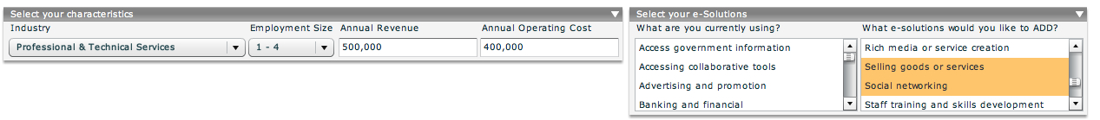
DEi Impact Calculator
- customize to individual needs -
1. Select your organization characteristics
2. Select your actual and needed e-Solutions
© Strategic Networks Group, Inc. 2012
Source: SNG Digital Economy Database n = 26,200

Slide 34
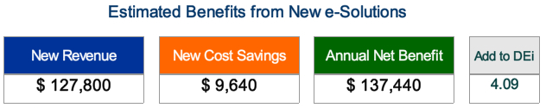
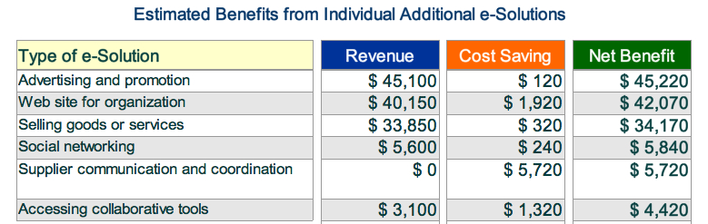
DEi Impact Calculator
- choose e-strategy based on ROI -
3. See your potential benefits from increased utilization
4. Details of potential revenues and cost savings
© Strategic Networks Group, Inc. 2012
Source: SNG Digital Economy Database n = 27,200

